Slide 1
Pointers and Arrays
And C-style strings

Slide 2
Agenda
Memory regions
Pointers
Arrays
Arrays and Pointers

Slide 3
Memory regions
Each C++ variable is stored in a memory region
The size of the region depends on the variable’s type

Slide 4
Each Variable is Stored in a Memory Region
string a = “cse 250”;
int myint = 15;
0x000000
15
4 bytes long
“cse 250”
0xf3c453
0xfa4bc3
I’m lying to you
0xffffff

Slide 5
Sizes of Some Basic Data Types
cout << "sizeof(char) = " << sizeof(char) << endl; // 1 cout << "sizeof(char&) = " << sizeof(char&) << endl; // 1 cout << "sizeof(int) = " << sizeof(int) << endl; // 4 cout << "sizeof(int&) = " << sizeof(int&) << endl; // 4 cout << "sizeof(long int) = " << sizeof(long int) << endl; // 8 cout << "sizeof(bool) = " << sizeof(bool) << endl; // 1 cout << "sizeof(float) = " << sizeof(float) << endl; // 4 cout << "sizeof(double) = " << sizeof(double) << endl; // 8 cout << "sizeof(string) = " << sizeof(string) << endl; // 8
This returns 8, believe it or not; The theoretical limit is given by
string().max_size() gives 4,611,686,018,427,387,897

Slide 6
Where in memory? Use “address of” op
#include <iostream>
using namespace std;
int main()
{
int a = 12345;
cout << "Address of a is at: " << &a << endl;
// get something like 0x7fff6425d7c4
return 0;
}
32-bit architecture: an address is 4 bytes long
64-bit architecture: an address is 8 bytes long
These are virtual addresses

Slide 7
Pointers
A pointer is a variable that holds a memory address
We often want a pointer to a particular type
Pointers are extremely powerful (java hides it from us!)

Slide 8
Declaring Pointers
int *i_ptr; // i_ptr is a pointer to an integer
char *c_ptr; // c_ptr is a pointer to a character
string *s_ptr; // s_ptr is a pointer to a string
cout << "sizeof(i_ptr) = " << sizeof(char*) << endl;
cout << "sizeof(char*) = " << sizeof(char*) << endl;
cout << "sizeof(int*) = " << sizeof(int*) << endl;
cout << "sizeof(string*) = " << sizeof(string*) << endl;

Slide 9
Assigning and Dereferencing Pointers
i_ptr
int x = 10;
int *i_ptr;
i_ptr = &x; // addr of 1st byte of the 4 bytes long x.
cout << "x = " << x << endl; // this prints x = 10
cout << "x = " << *i_ptr << endl; // also prints x = 10
*i_ptr = 20;
cout << "x = " << x << endl; // this prints x = 20
cout << "x = " << *i_ptr << endl; // also prints x = 20
int y = 30;
i_ptr = &y;
cout << "y = " << *i_ptr << endl; // this prints y = 30
*i_ptr = 40
cout << "y = " << y << endl; // this prints y = 40
10
20
30
40

Slide 10
Visualize
0x000000
int myint = 15
15
0xf3c453
0xf3c453
int* ptr = &myint
0xffffff

Slide 11
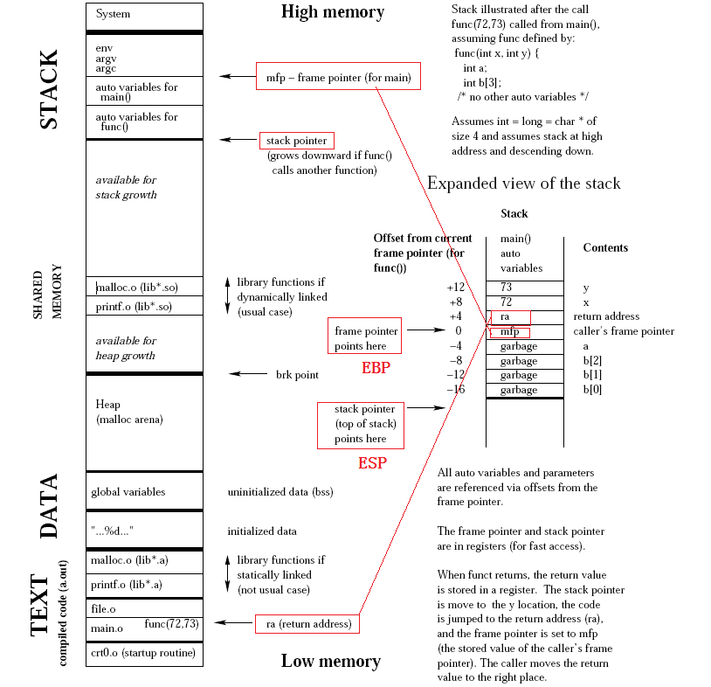

Slide 12
Pointers and References
// pt.cpp: testing pointers #include <iostream> using namespace std; void swap(int *a, int *b) { int temp=*a; *a=*b; *b=temp; } int main() { int x = 1, y=9; swap(&x, &y); cout << "x = " << x << endl; // x = 9 cout << "y = " << y << endl; // y = 1 return 0; }
Note that the pointers a, b are passed by value

Slide 13
Pointers and References
NO: pointer to reference
YES: reference to pointer

Slide 14
Pointers to Objects and the -> operator
void print_reversed_sentence(const string* s_ptr) { int start; int end = s_ptr->length()-1; // or end = (*s_ptr).length() - 1 for (start = s_ptr->length()-1; start>=0; start--) { if ( ( (*s_ptr)[start] == ' ') && (start < end) ) { cout << s_ptr->substr(start+1,end-start) << ' '; end = start-1; } } if (start < end) cout << s_ptr->substr(start+1,end-start+1) << endl; }
(*obj_ptr).member is the same as obj->member

Slide 15
Pointer to Pointer, Ad Infinitum
#include <iostream> using namespace std; void swap(string **a, string **b)
{
string* temp = *a; *a = *b; *b = temp;
} int main()
{ string first("David"); string last("Blaine"); string* p1 = &first; string* p2 = &last; swap(&p1, &p2); cout << "p1 points to " << *p1 << endl; // "Blaine" cout << "p2 points to " << *p2 << endl; // "David" return 0; }

Slide 16


ARRAYS
Series of elements of the same type placed in contiguous memory locations.
Like any regular variable, arrays must be declared before it is used.
Array size must be a constant expression
Notes:
Since arrays are blocks of memory whose size must be determined are compile time before the program runs.

Slide 17
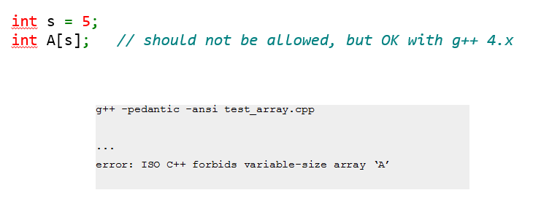
Some extensions use dynamic arrays – but this is not recommended.

Slide 18
Array Initialization:
int foo[5];
int foo[5] = { 16, 2, 77, 40, 120 };
int foo[5] = { 16, 2, 3};
int foo[5] = { };

Slide 19
The evolution of C++ has led to universal initialization for arrays. What this means is that it is no longer necessary to put the = sign between the declaration and the initialization.
int foo[ ] = { 1, 2, 3 , 4, 5};
int foo[ ] { 1 , 2, 3 ,4 , 5};

Slide 20
Accessing array elements:
foo[2] = 75;
x = foo[2];
In C++ , it is syntactically correct to exceed the valid range of indices. Accessing out of range elements do not create problems during compile time but it can cause run time errors.

Slide 21
Example : Definition and initialization
int main()
{ const size_t s = 5; int A[s]; int B[5] = {1, 2, 3, 4, 5}; int C[] = {1, 2, 3, 4, 5}; // the same as saying int C[5] for (size_t i=0; i<s; i++) { A[i] = i*i; B[i] += A[i]; C[i] += B[i]; } for (size_t i=0; i<s; i++) cout << C[i] << ' '; cout << endl; return 0; }

Slide 22
Strings in C++
C- style character string that originated with C language continues to be supported in C++
This is actually a 1-D array of characters terminated by a ‘\0’ – NULL character.
Eg :
char greeting[6] = {‘h’,’e’,’l’,’l’,’o’,’\0’}

Slide 23
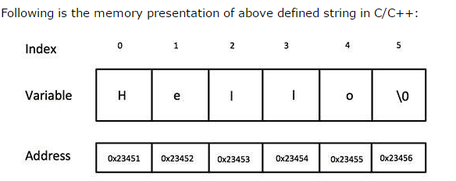

Slide 24
Examples : C-style strings
char name[] = "David";
// name has 6 elements, the last is implicitly '\0’
cout << sizeof(name) << endl; // prints 6
int i=0;
while (name[i] != '\0’)
cout << name[i++];
cout << endl;
cout << name << endl; // same effect
char name[5] = "David"; // compilation error

Slide 25
Initializing C-style string (char array)
#include <iostream> using namespace std; int main()
{ char name[] = "David"; char another[] = { 'D', 'a', 'v', 'i', 'd', '\0' }; cout << name << endl; cout << another << endl; return 0; }

Slide 26
String literals
The expression "David" is called a string literal
char name[] = "This is a very long " "name and thus won't fit " "on a line"; cout << name; // get "This is a very long name and thus won't fit in a line"

Slide 27
Character arrays with ‘\0’ in the middle
Perfectly fine to have them; just be careful!
char sa[] = "Only up to here\0The rest can still be printed";
cout << sa << endl; for (i=0; i< sizeof(sa); i++) { if (sa[i] != '\0') cout << sa[i]; else cout << "[NULL CHAR]"; } cout << endl; string str_obj = sa; cout << str_obj; // prints "Only up to here"

Slide 28
Why do we care about C-style strings?
They are very efficient
Necessary in system programming
Some C++ functions take C-style string arguments

Slide 29
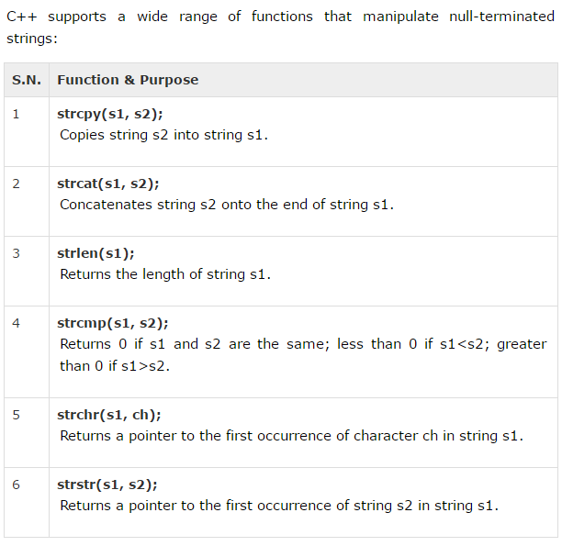
String functions

Slide 30
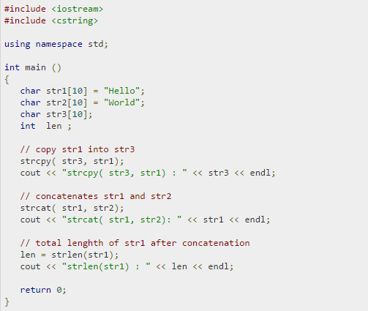
Example

Slide 31

Output

Slide 32
Quiz 2 discussion
Task 1 :
Write a program which prompts the user for the name of the input and output files.
Input file name : alice30.txt
Output file name : xray_alice.txt
In the output file, the program should store the line number and the line itself for each line where the word ‘Alice’ was mentioned irrespective of cases (lower or upper case).

Slide 33
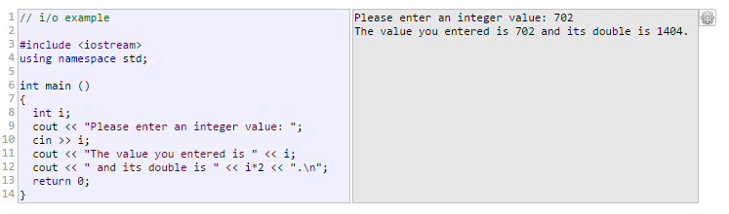
Prompting user input

Slide 34

File IO
C++ provides the following classes to perform IO from/to files:
We have already used cin from istream and cout from ostream.

Slide 35
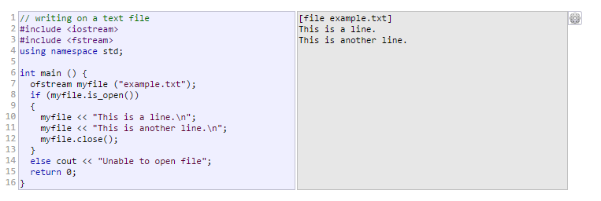
Example: Writing to file

Slide 36
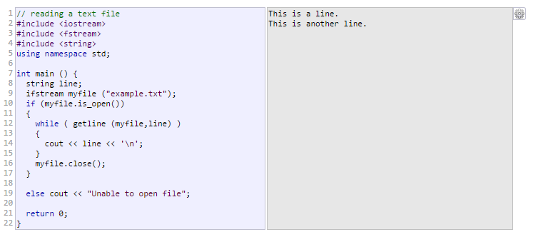
Example: Reading from file

Slide 37
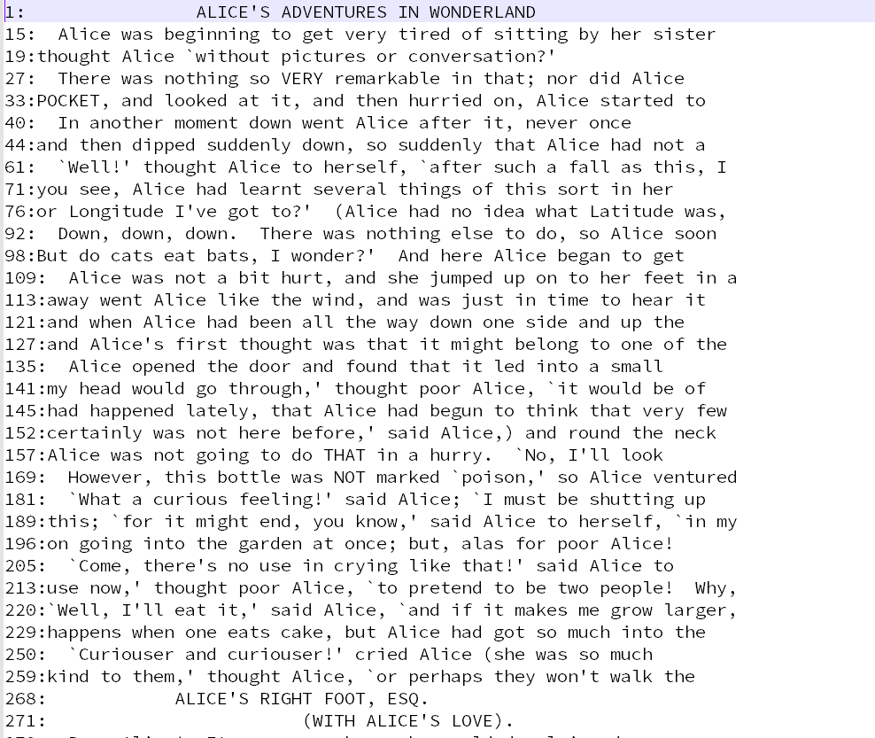
Screenshot of output file for Task 1

Slide 38
ifstream.open()
ifstream ifs;
ifs.open("/usr/share/dict/words");
char dict[] = "/usr/share/dict/words";
ifstream ifs;
ifs.open(dict);
string dict = "/usr/share/dict/words";
ifstream ifs;
ifs.open(dict);
Compilation error under C++03 (/usr/bin/g++ in timberlake)
Perfectly valid under C++11 (/util/bin/g++ in timberlake)

Slide 39
Task 2 :
For your second program, read the same file, alice30.txt (your program should prompt the user for the name of the input and output files), and cout the number of occurrences of each character A to Z (irrespective of cases, i.e., do not distinguish between lower and upper cases).
Save the information into letter_count.txt file.

Slide 40
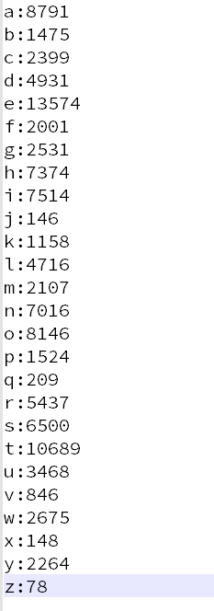
Screenshot of output file for Task 2

